Slide 1

The Jacobian in Statics
This Jacobian matrix (J(q)) is called Velocity Jacobian. There is
another Jacobian matrix called, Jacobian in Statics which maps
the end-effecter force and moment to the required joint torques.
In other words, given the end-effecter force and moment, this
Jacobian matrix can determine the required joint torques.
Picture taken from Robotics and Control by Nagrath and Mittal
Derivation of Jacobian in Statics
Principle of virtual work: Assume infinitesimal displacements at the joints, and end-effecter. Then the total
work done is as follows.

Slide 2
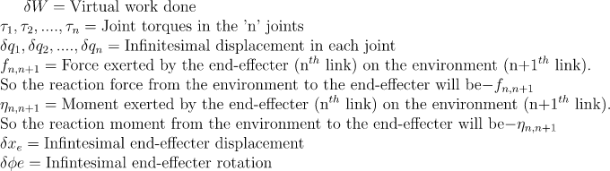
where
Picture taken from Robotics and Control by Nagrath and Mittal

Slide 3
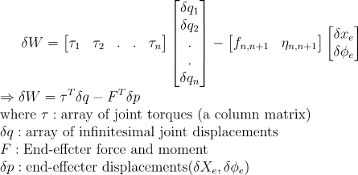
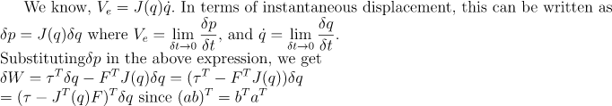

Slide 4

According to principle of virtual work, the manipulator is in static equilibrium.
This J^{T}(q) is called the Jacobian in statics.
Example: The 3-DOF articulated manipulator has to exert
[20 30 -40 0 0 0]^{T} at the end-effecter. Determine the joint torques
required.
Solution:
First determine velocity Jacobian J(q). It will be 6x3 matrix; J^{T}(q)
will be 3x6 matrix. Now ‘F’ is 6x1. So 3x6 and 6x1, will give you
3x1 matrix of joint torques. Since there are 3 joints, we need 3 joint torques.
Picture taken from Robotics and Control by Nagrath and Mittal

